Slide 1

Useful open science tools to do research in psychiatry
Thomas Gargot
thomas_gargot@hotmail.com
EPA Congress,
Tuesday March 6th

Slide 2






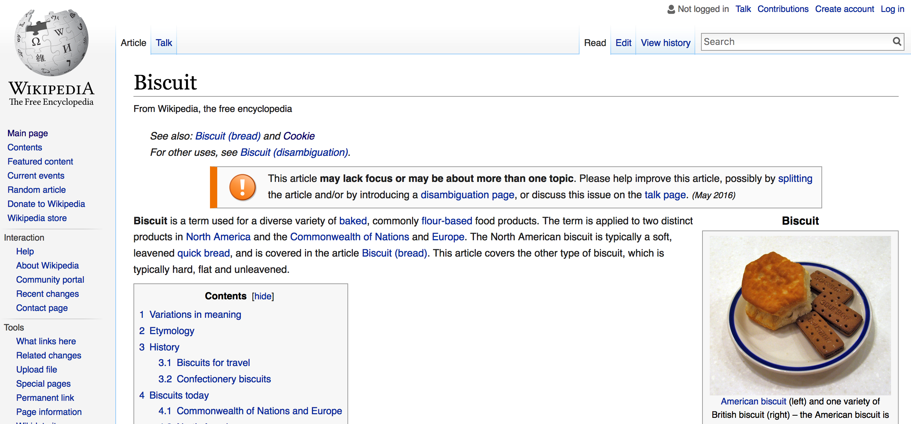
Randomizer.org
Useful open science tools to do research in psychiatry
Collect data
Limesurvey
Analyse data
Share data
OSF and
GitHub
Write an article
Make the knowledge more visible

Slide 3
Goals of the workshop
Understand the challenges of open science
Learn the names of few tools
Consider you own research/projects
Rate cakes

Slide 4



Who I am
Psychiatrist in Paris
PhD Student on Computer Science :
use of IT in school
Interest in IT and psychotherapy (CBT)
Master in Cognitive science in ENS
Former IT secretary of EFPT
Psychotherapy WG chairman

Slide 5
Disclosure
None

Slide 6
Ethical issues

Slide 7
Problems
Cost : How much will it cost to run this study?
Method : What do they mean when they did this analysis?
Licence : Does someone has the last version of this software ?
Memory: where is my data, how to re-use, share it?
Paywall : I can’t get this article
Visibility: Nobody cares about what us

Slide 8

Publication lucrative vicious circle
Collect articles for free
Paywall and Sell it
Reviewing for free
Publishing
(cost decrease)
Research privatization

Slide 9

https://www.youtube.com/watch?v=WnxqoP-c0ZE&list=PLKipY1cRnemK1Fn6PbVe5zkOfxLlI02YY&index=6

Slide 10
Goals
Dicrease costs
Improve transparency
Improve accessibility to softwares, articles, and re-use of data
Improve visibility for public
Is that really possible ?!?

Slide 11
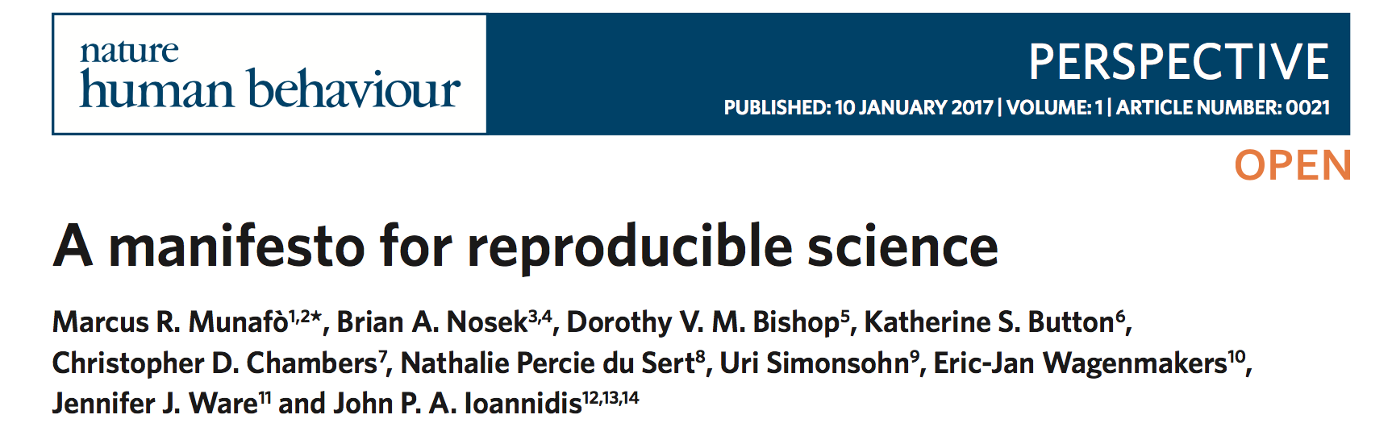
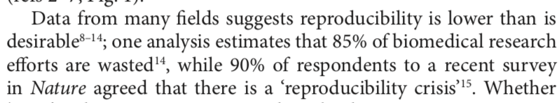
Why is there a need for open science?

Slide 12

Information world
Share of information don’t decrease the ownership of the sharer
Rather, better accessibility improve possibilities of not anticipated use (hacking) and feedback
Open softwares are more flexible and have fewer bugs that closed one

Slide 13

Free / Open?
Open software: Free use, study, modification, duplication and sharing
≠ Freemium strategy (demonstration)
≠ centralisation and user data collection
https://www.qwant.com/?q=you%20are%20the%20product&t=images&o=0:0a530ac5ad25daeb329762e4a2da88f3

Slide 14
An example of Open science pathway
Hands-on

Slide 15
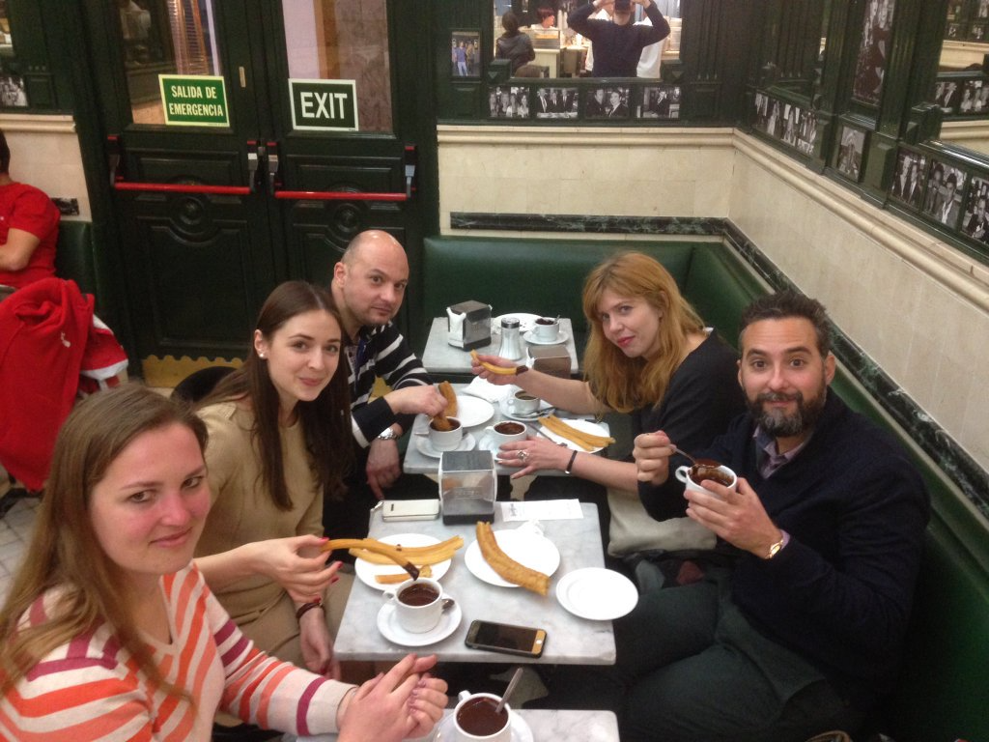
Research protocol
Make a data base of cookies tasting
Rate them in an international context
Select the best cakes in the worlds
Sampling process during EPA congress, Madrid, 2016

Slide 16
Randomizer.org
Useful open science tools to do research in psychiatry

Slide 17
Randomizer.org

Slide 18
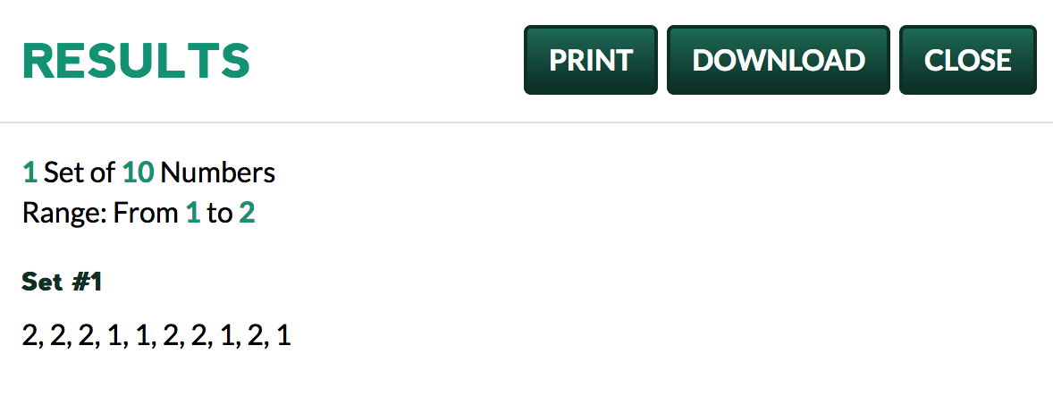
Randomizer.org

Slide 19
Randomizer.org
Useful open science tools to do research in psychiatry
Collect data
Limesurvey

Slide 20

Limesurvey
http://thecakereports.limequery.com

Slide 21
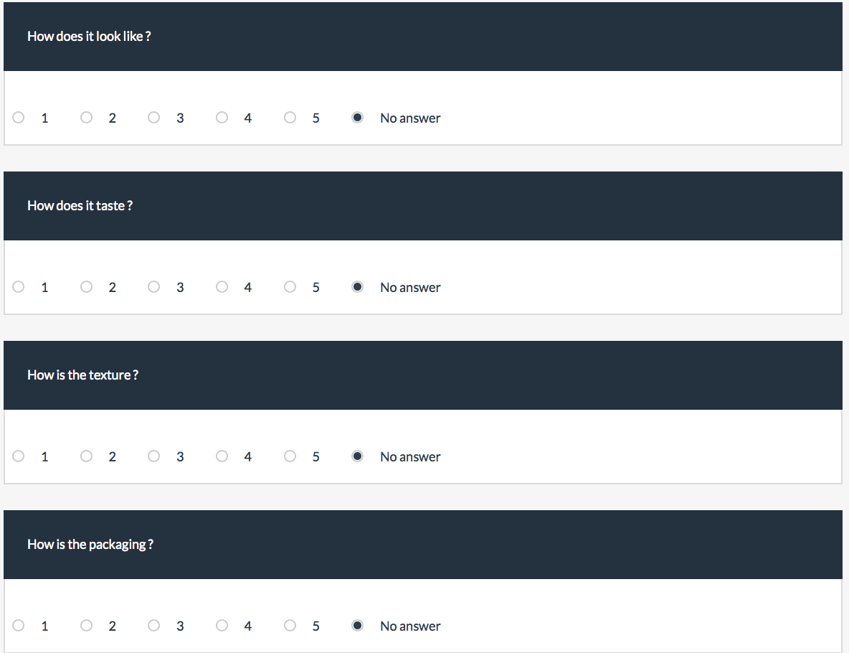

Slide 22
Randomizer.org
Useful open science tools to do research in psychiatry
Collect data
Limesurvey
Analyse data

Slide 23
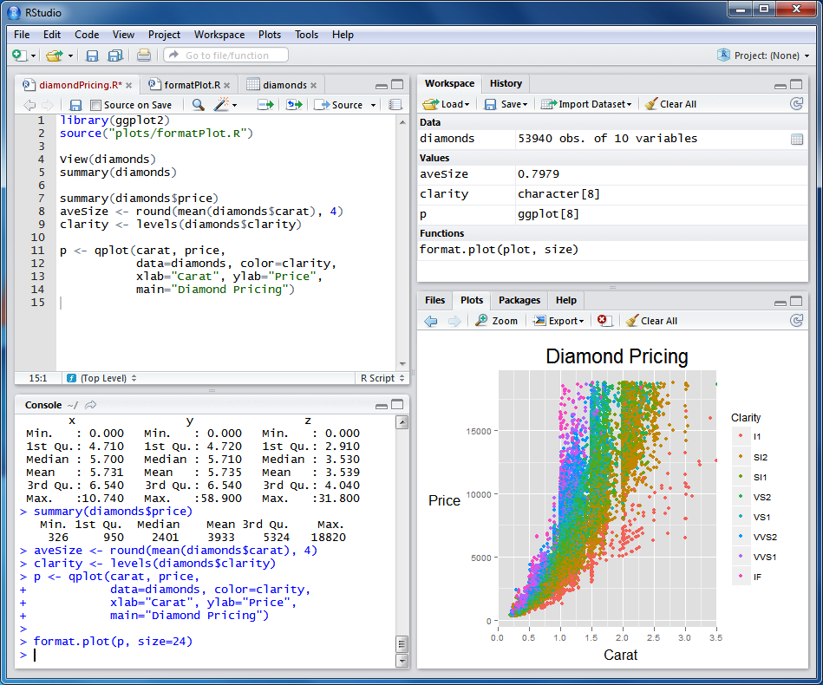

Slide 24
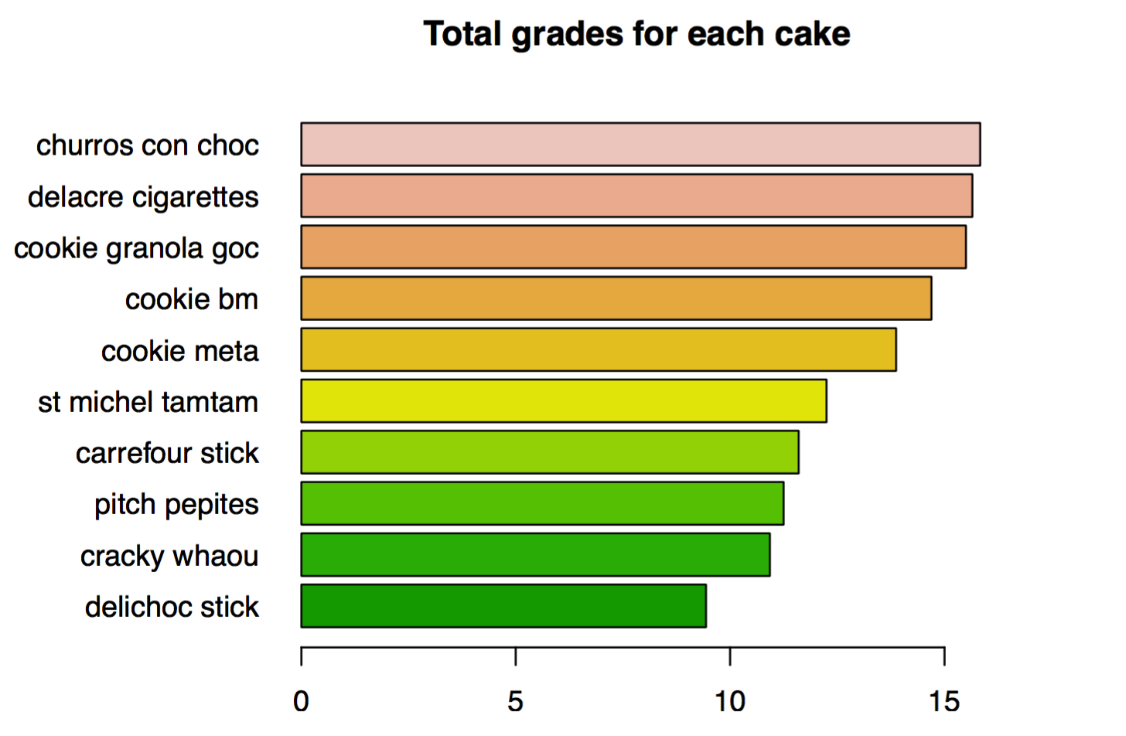

Slide 25
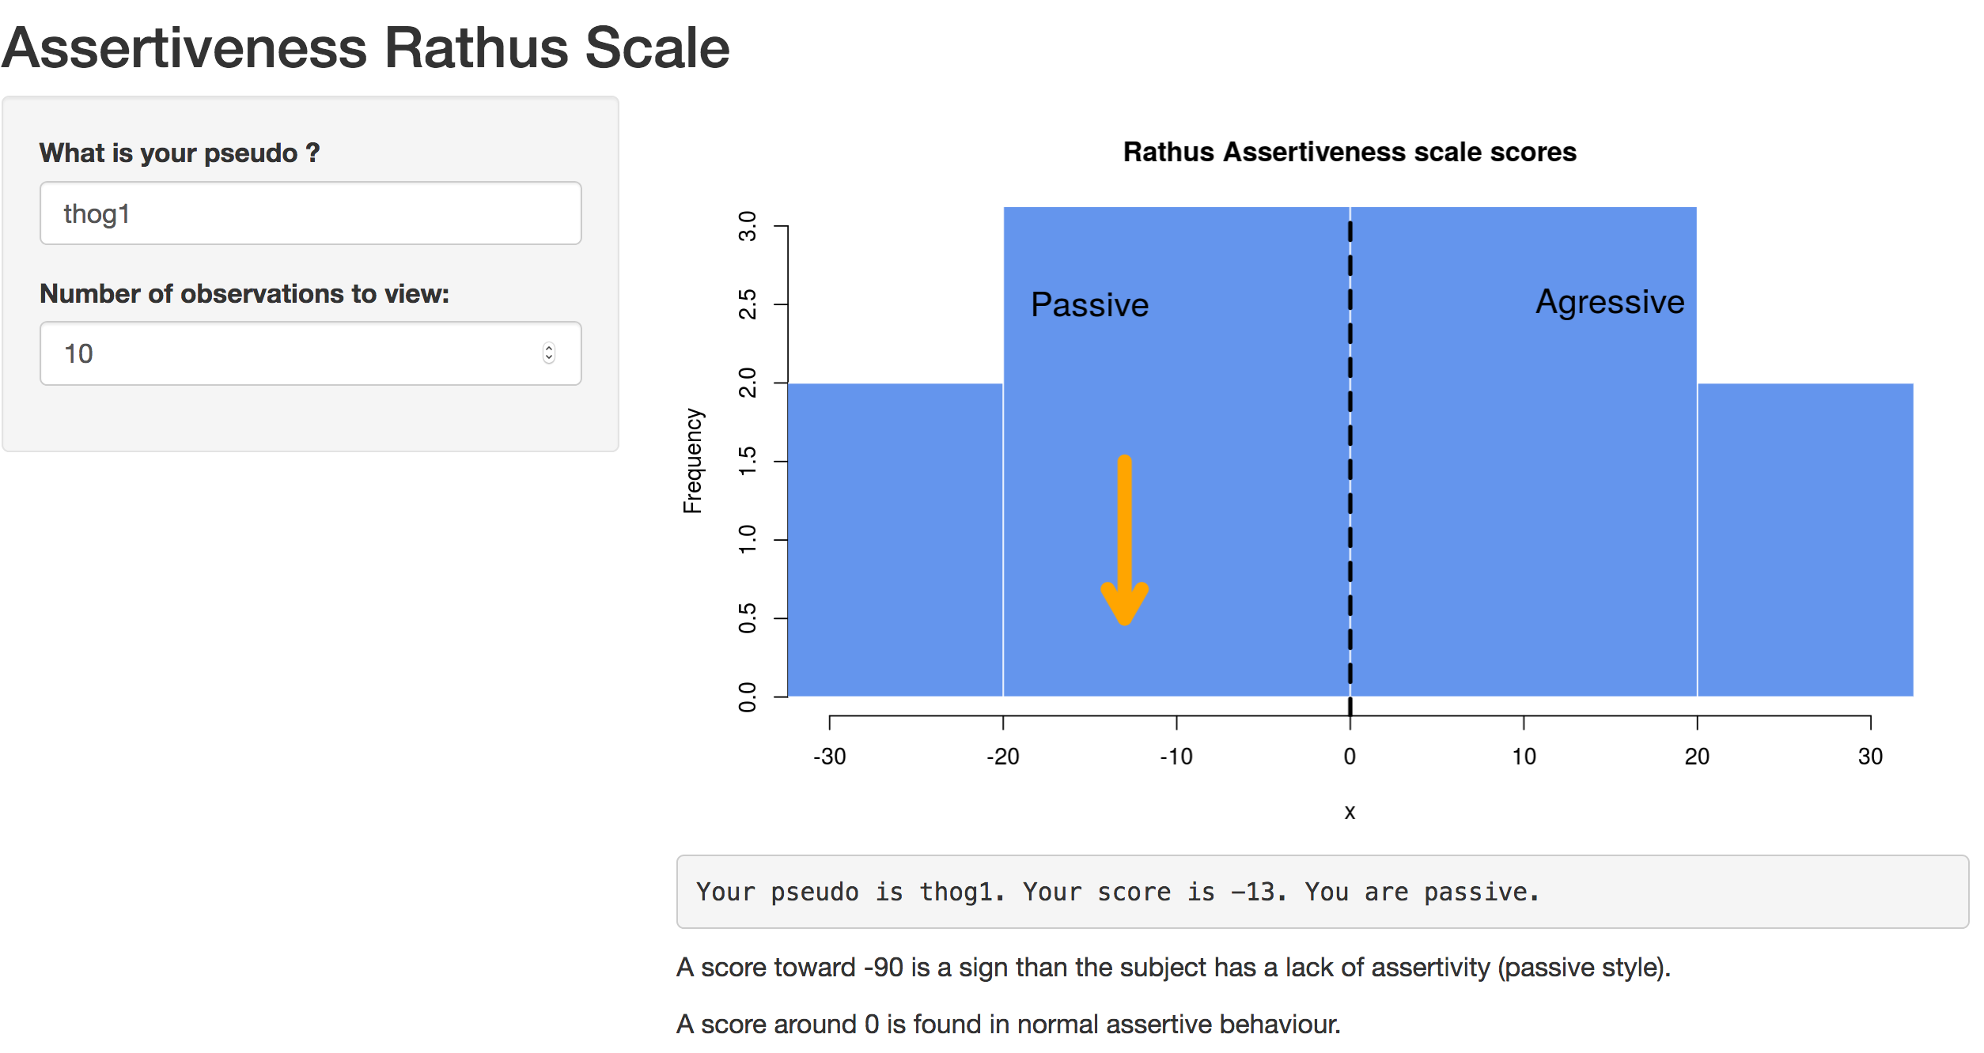
Connect Limesurvey with R ? : Shinyapps
https://ouphix.shinyapps.io/affiDeSoi/

Slide 26


Python
A little more fundamental and less user friendly, very used by computer scientists.
Python has very large possibilities :
collect data during a psychological experiment with pygame
Data analysis
Code a robot
Make a website

Slide 27
Randomizer.org
Useful open science tools to do research in psychiatry
Collect data
Limesurvey
Analyse data
Share data
OSF and
GitHub

Slide 28
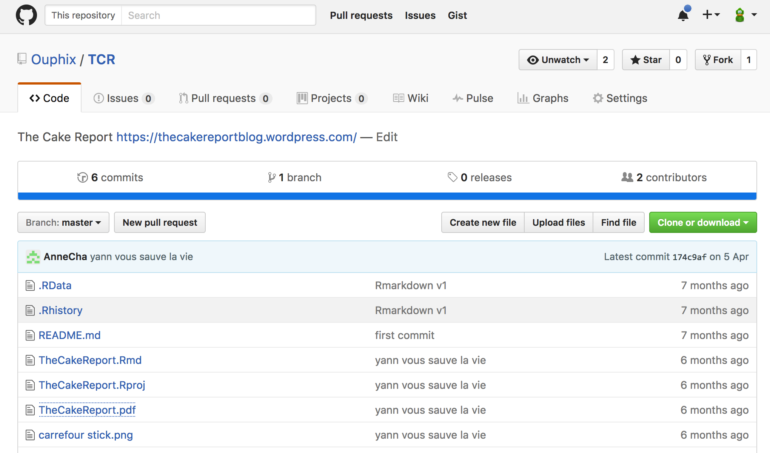
Git Hub
Share data

Slide 29
Randomizer.org
Useful open science tools to do research in psychiatry
Collect data
Limesurvey
Analyse data
Share data
OSF and
GitHub
Write an article

Slide 30

Equator Network

Slide 31
Collaborative writting

Slide 32
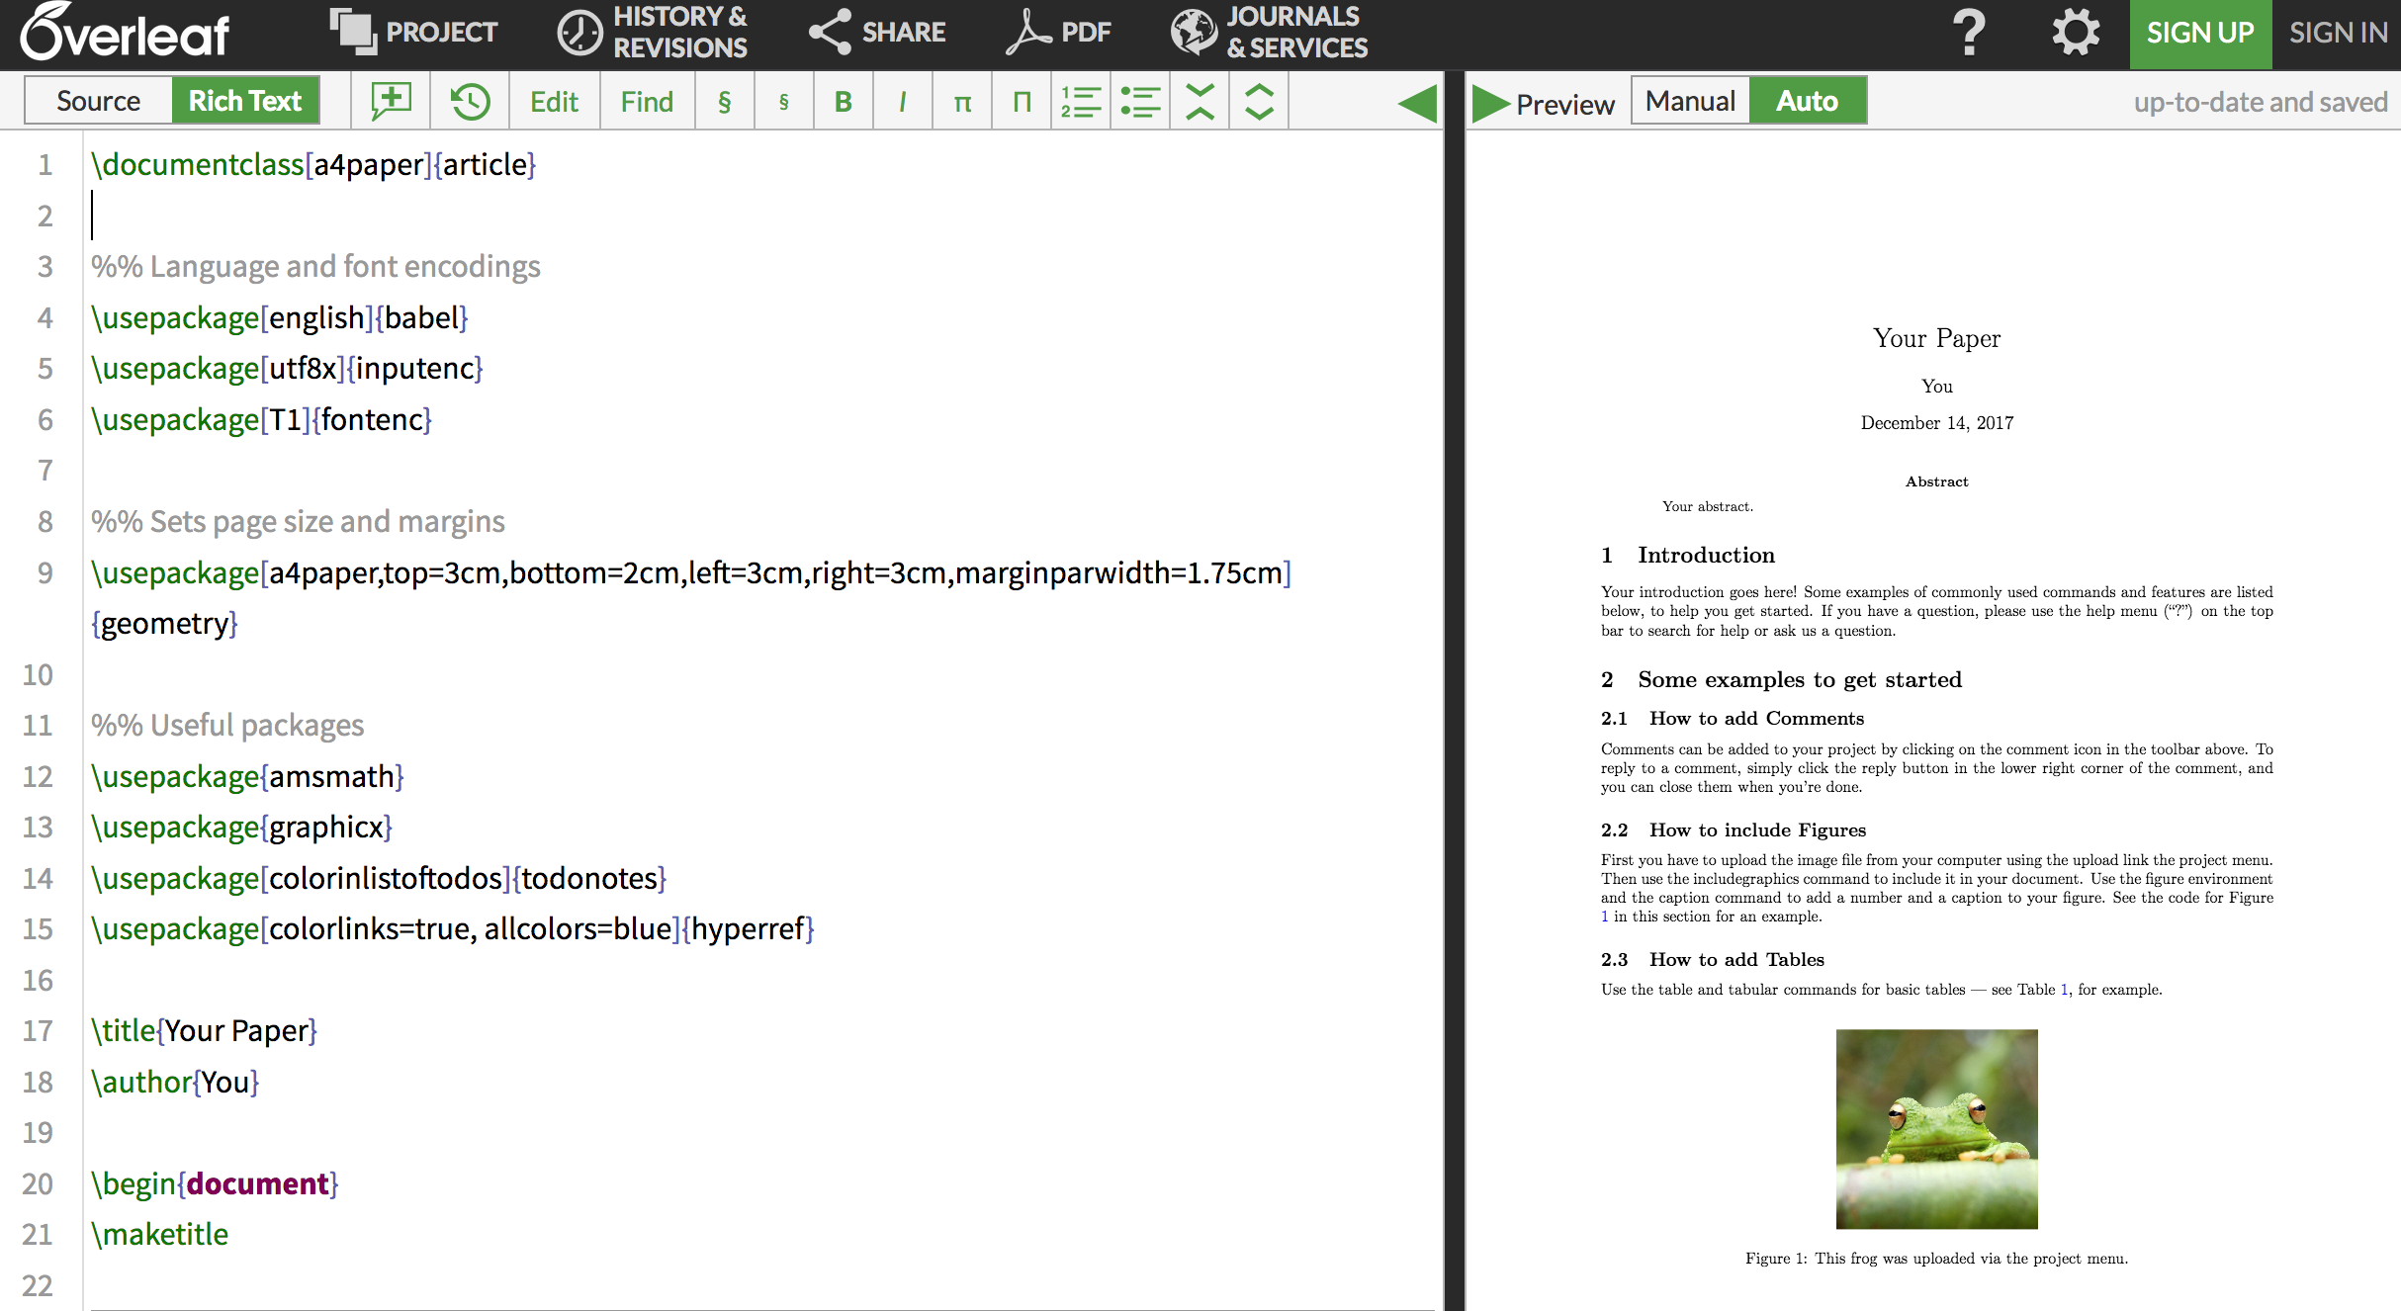

Slide 33
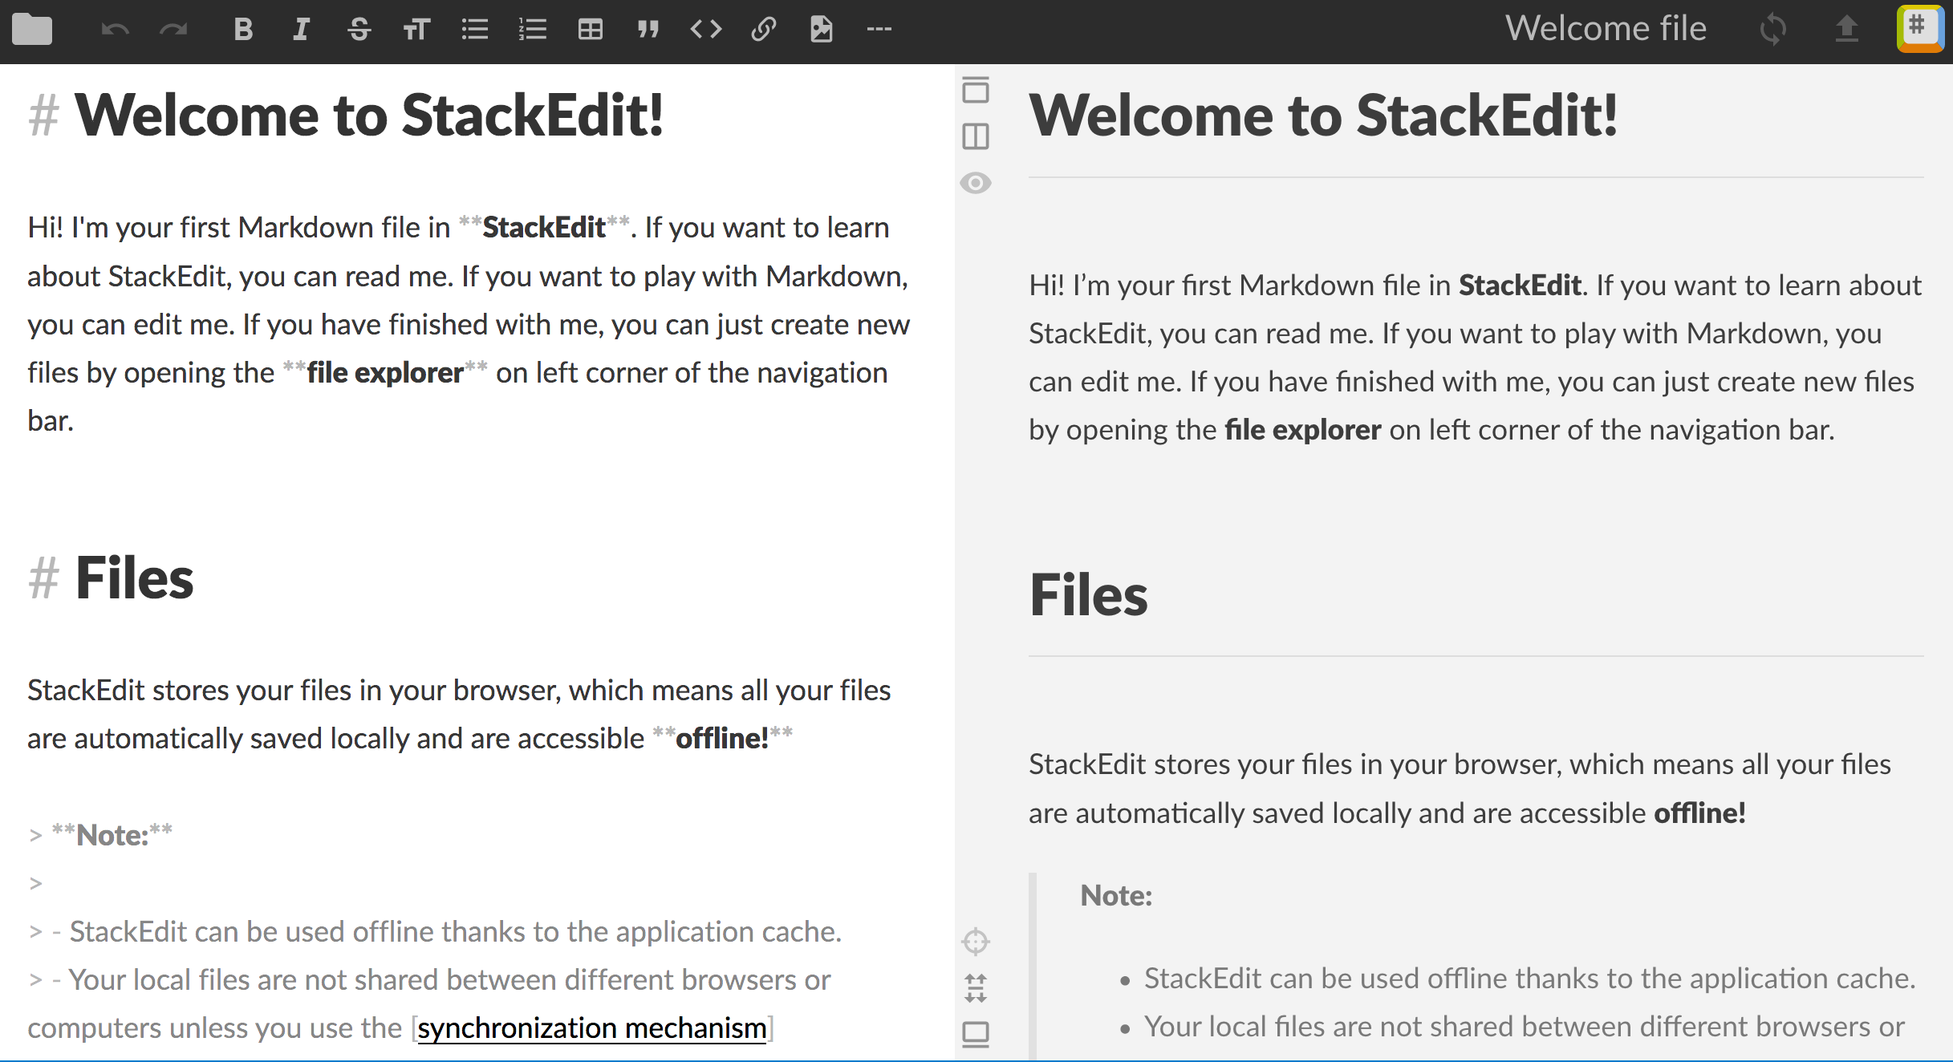

Slide 34


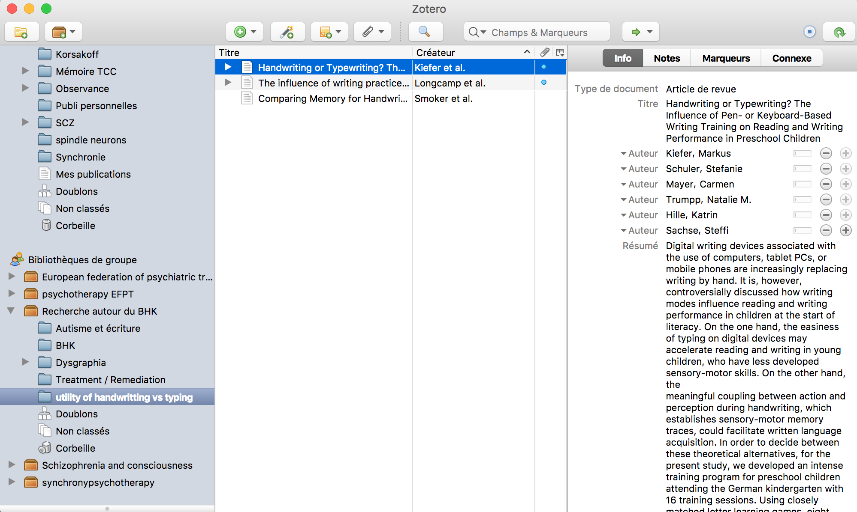
Select, gather, write and share bibliography

Slide 35
New ways to publish ?

Slide 36
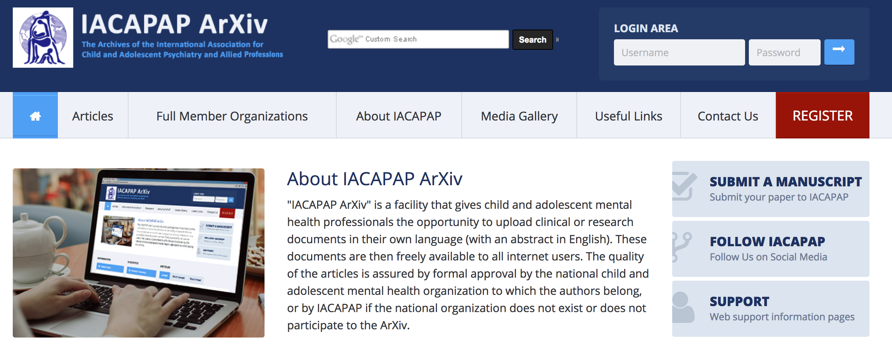



ArXiv : Preprints

Slide 37

https://www.pubpub.org/
Authorea

Slide 39
Share to general public

Slide 40
Randomizer.org
Useful open science tools to do research in psychiatry
Collect data
Limesurvey
Analyse data
Share data
OSF and
GitHub
Write an article
Make the knowledge more visible

Slide 41
https://en.wikipedia.org/

Slide 42
https://en.wikipedia.org/

Slide 43

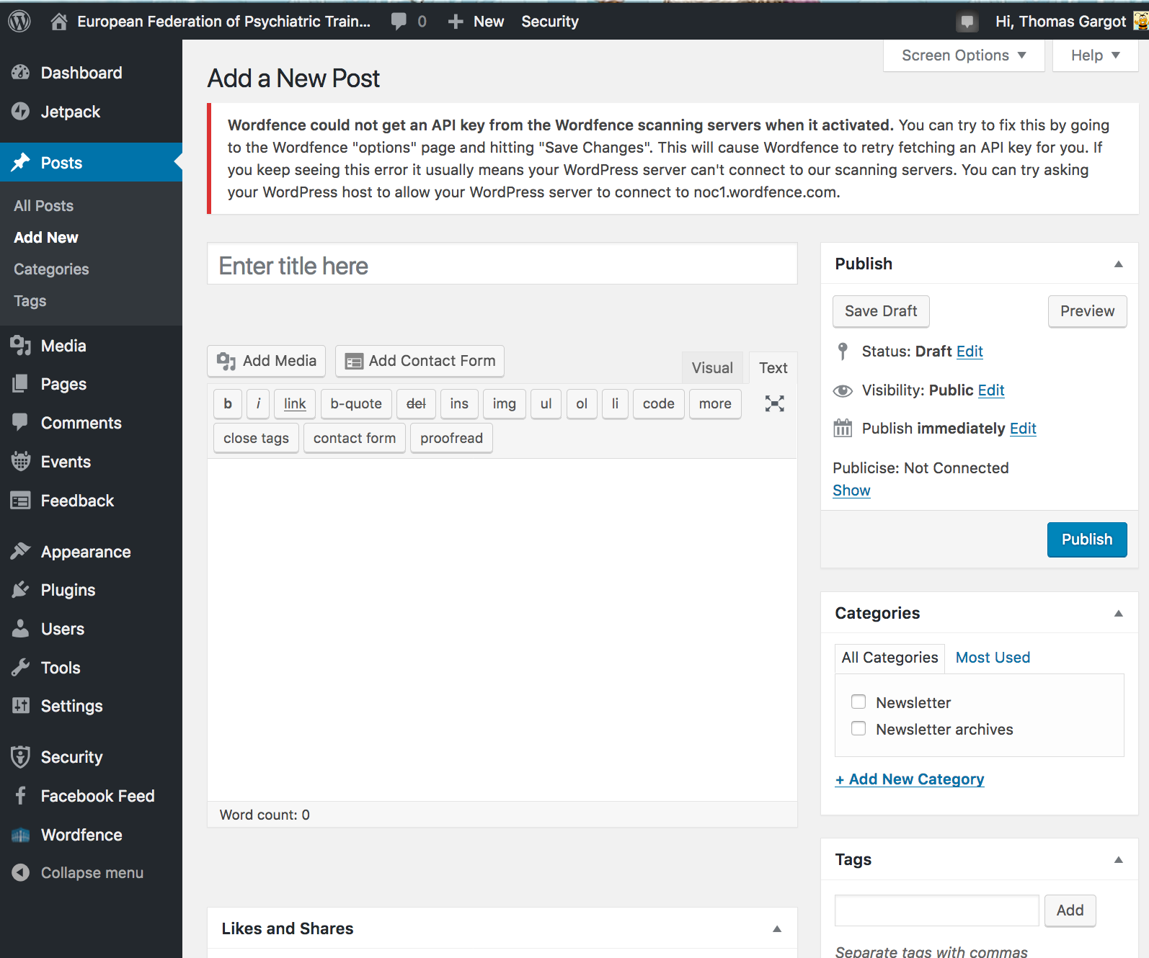
Wordpress

Slide 44
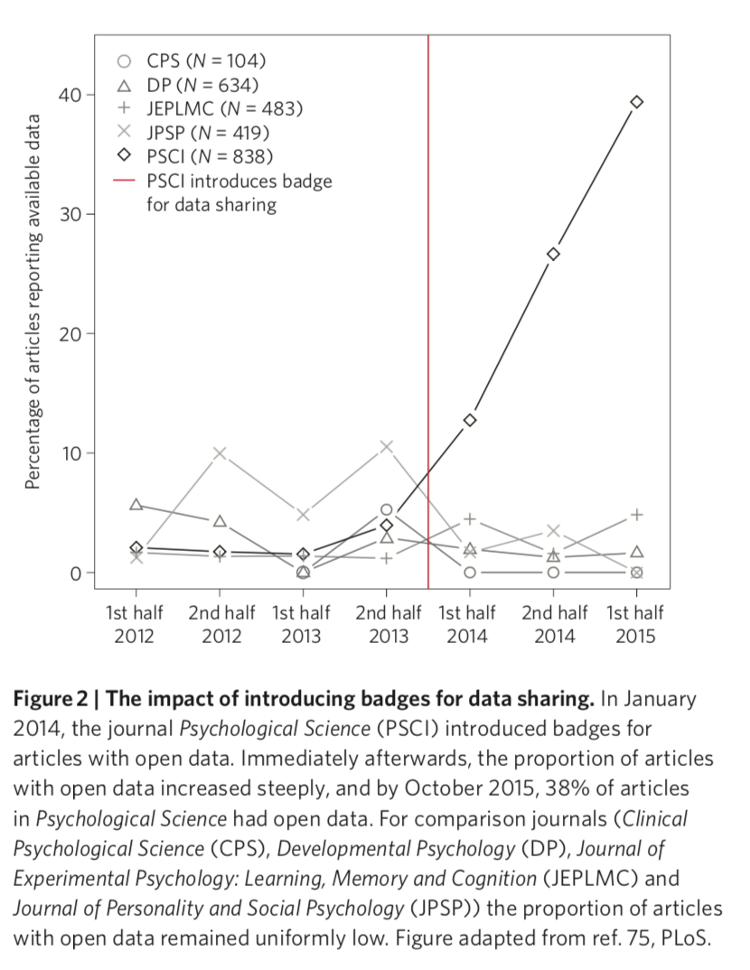



Badges

Slide 45
Randomizer.org
Useful open science tools to do research in psychiatry
Collect data :
Limesurvey
Analyse data
Share data
OSF and
GitHub
Write an article
Make the knowledge more visible

Slide 46

Thank you for your attention
thomas_gargot@hotmail.com

Slide 47
